Slide 1

CSS496
Show & Tell #2
Kristina Chen | CSS496

Slide 2
3 days, 3 themes
For my course, CyberQuest students will be going through the story of a scam/fraud. They will use the first day to discover what information security/technical literacy is. On this first day they will be introduced to the “fraud” that has happened on our main character Samuel. Then the second day they will learn a little about the “hacker’s” side and how they scammed the main character. Lastly on the third day we will learn a little more about our “hero” who is able to recover their assets and teach the main character about how they can take measures to protect themselves in the future.

Slide 3
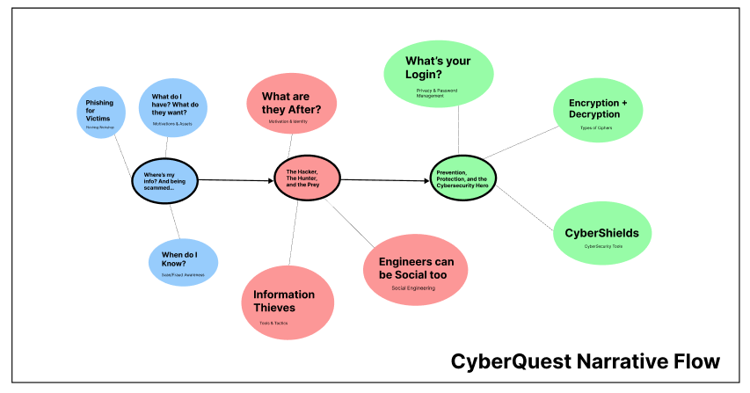
Themes

Slide 4
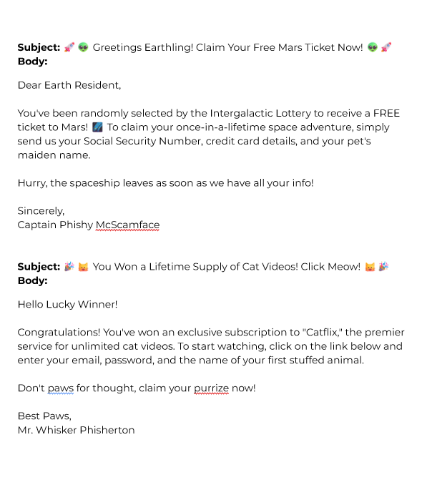
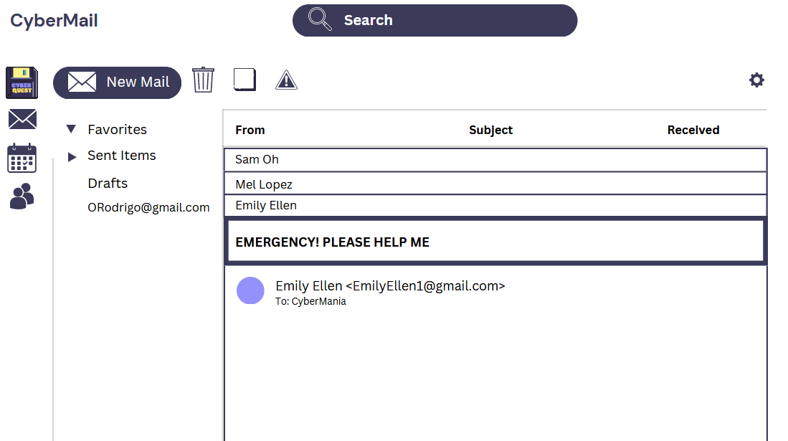
Phishing Workshop / Examples

Slide 5
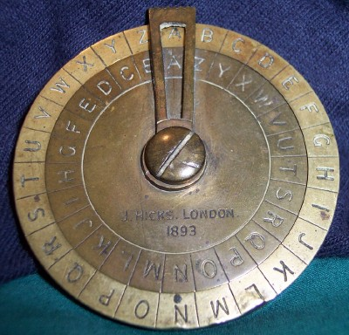
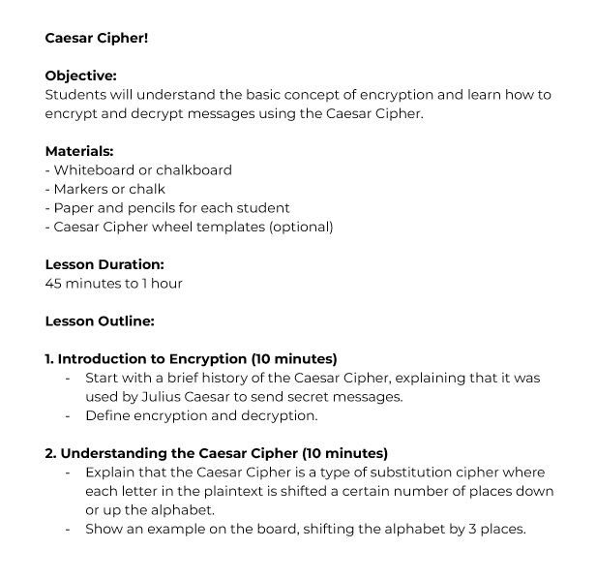
Encryption (Caesar Cipher)

Slide 6
Feedback
Questions
Professor Kim:
“Where will you include metrics and learning goals for educators?”
I will include metrics and learning goals in the daily overview of the week and days. In addition there will be more of those goals/objectives in the educator preparation document. Those goals/objectives will help lead educators in the direction necessary for the curriculum involved.
N/A

